Slide 1






PRE SHOW:
CYBERWARFARE

Slide 2
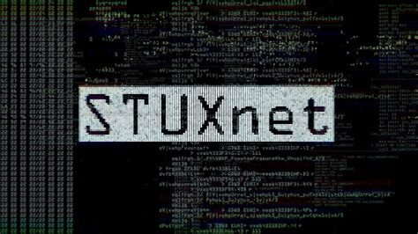
HOW AMERICA BROKE IRAN’S NUCLEAR SYSTEMS FROM THOUSANDS OF MILES AWAY (JUNE 2010)

Slide 3
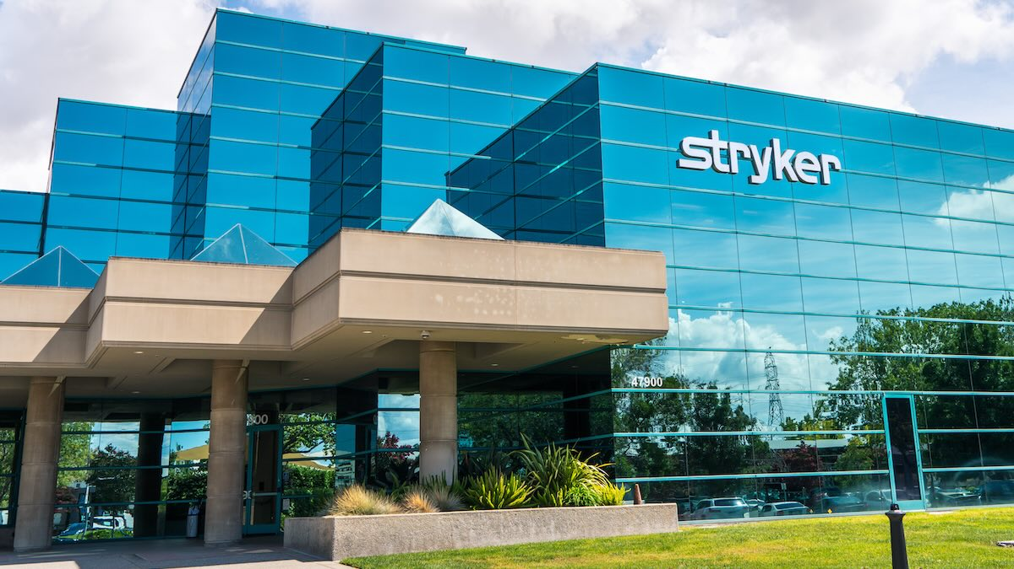
BRINGING A HEALTHCARE GIANT TO NEAR DESTRUCTION

Slide 4
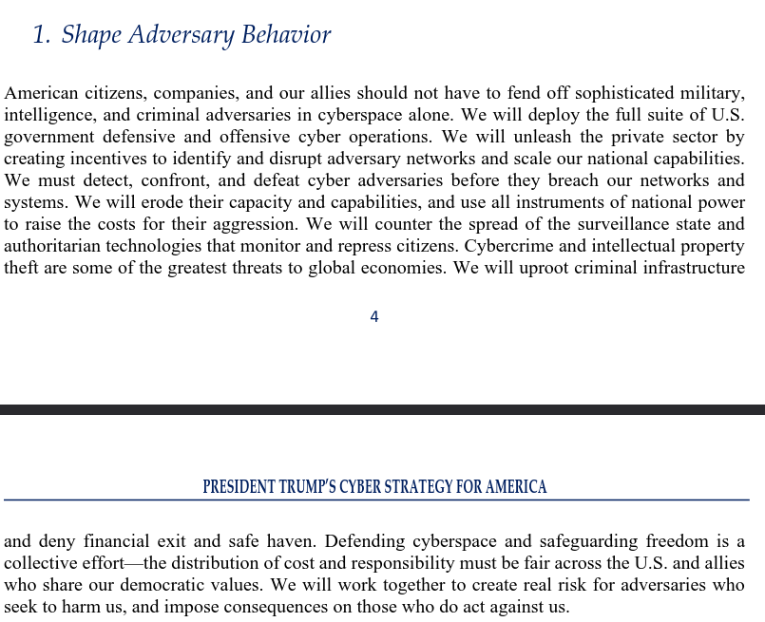
A HEATED CONVERSATION. SHOULD WE JOIN THE RANKS OF THE HACKERS?

Slide 5




CYBER
FORENSICS
FINAL PROJECT DAY!

Slide 6





OBJECTIVES
1
Review some challenges from the AITCC. Solutions, etc.
2
Lets talk my favorite catagory. Forensics. and disscuss some strategies
3
Wrapping up the project, summary, and future learning

Slide 7
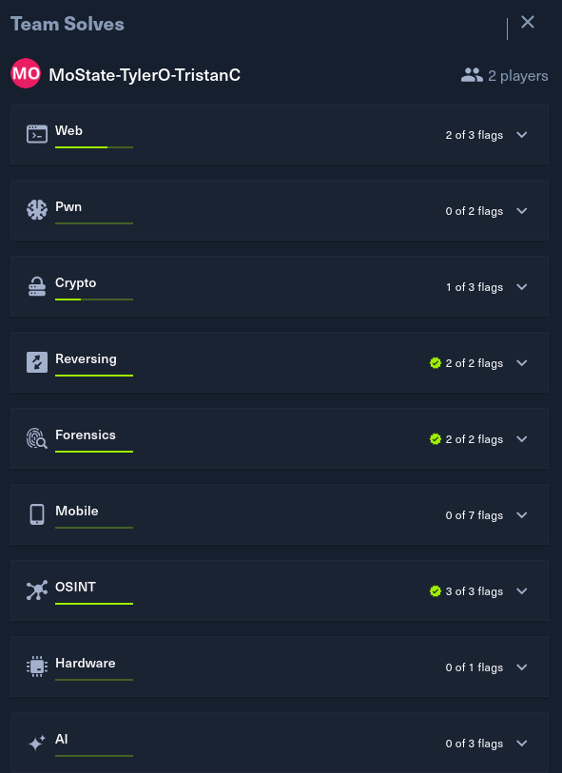
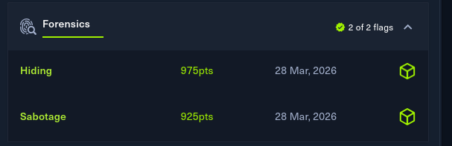

CHALLENGE REVIEW

Slide 8

WHAT IS COMPUTER FORENSICS?
The use of science and technology to investigate and establish facts in criminal or civil courts of law.
Done through:
Log analysis (Hey callback!)
Picking drives apart
Adding law and non-repudiation
Cannot deny actions took place

Slide 9


RIGHT. HOW?
Forensics can be done in serveral ways
Log analysis via static log files (Common CTF Challenge)
Analysis of an entire disk image of a computer
Analysis of the memory or programs of a computer
Tracing of an email back to original sender
The important distinction between forensics and incident repsonse is time. Responders have limited time while forensics can take place over months long time periods.

Slide 10

LETS LEARN LOG FORENSICS
We will break down a sample file using linux commands.
Linux is a scary tool because of it’s terminal
AND its an amazing tool because of its terminal
A set of 5 commands however will get you through many CTF and future interview questions.

Slide 11
LINUX COMMANDS
CAT (FILENAME)
GREP
CUT -D “ “ -F2
SORT
UNIQ -C
Will print the raw contents of the file to the screen
Searches for text in a specified file or when in a chained command
Allows the cutting of content based on a seperator. Extermely helpful tool in making large blocks of text smaller for answers
Allows sorting of content numerically or alphabetically.
Important to do before unique commands to group content
Counts unique entries present. Shows counts of them. Useful in looking for numbers of how often something appears

Slide 12
LAB TIME:
MONGOBLEED

Slide 13



WELL, ITS OVER. WHAT NOW?
Continue Working
If you enjoyed the items for capture the flags, keep up to date with ctftime.org or tryhackme and hackthebox for their CTFs they host. Work with their platforms to continue to learn more
Personal Projects
The next slide is ideas for personal projects based on the content we have gone over in this project. I’m glad to help anyone with these as you need!

Slide 14
PROJECTS
(W2) Create an “OSINT Report” on yourself, what information can you find?
(W3) Make a splunk trial account and connect a test computer or find some test logs to use and practice searching and using the query language
(W5) Install a FlareVM and use it with either CTF challenges or real malware and try to make a report based on what you find in how the malware works
(W7) Use HTB / THM to break into virtual machines / Set up a vulnerable practice range and make a report over what was found)
(W8) Try to complete as many challenges in OWASP juice shop as possible

Slide 15
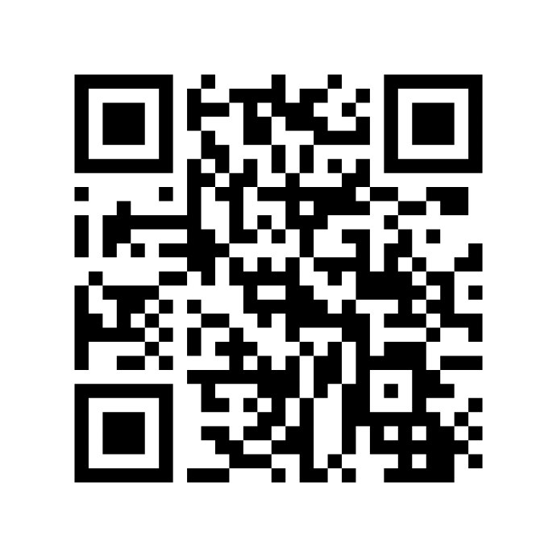




CONTACT ME
816-591-6175
olsontyler.com
olsontyler@pm.me

Slide 16


THANK YOU

